Slide 1


DEEP LEARNING BASED TEXT CLASSIFICATION
By
D. Mark Preetham(20J41A6616)
Ch. Sneha Manasa(20J41A6615)
A. Dhanashree(20J41A6604)
N. Chandana(20J41A6637)
Under the Esteemed Guidance of
Mr. B. Srinath
Assistant Professor
Department of Computer Science & Engineering(AIML)
Malla Reddy Engineering College (Autonomous)
Maisammaguda, Dhulapally(Po), Via Kompally,
Secunderabad-500100.

Slide 2

Introduction
Objectives
Existing System
Proposed System
Methodology
Conclusion
References

Slide 3
Text classification can be described as a machine learning technique to classify the type of text into a particular category
Text classification deals with unstructured/raw data and categorizes them based on similarities.
A model which will analyze raw data and train the model to categorize the data based on the features
In this we have multiple steps which processes data to progressively extract higher level features from the data.
Various Neural Network Mechanisms or models which have been used for Text Classification such as CNN (Convolutional Neural Network), RNN (Recurrent Neural Network), LSTM (Long Short-Term Memory) Models.

Slide 4
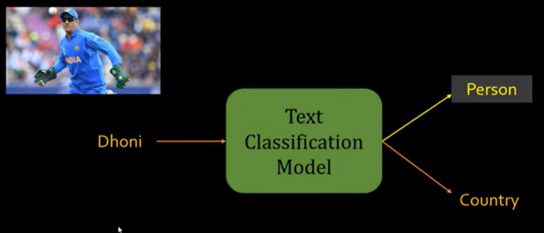
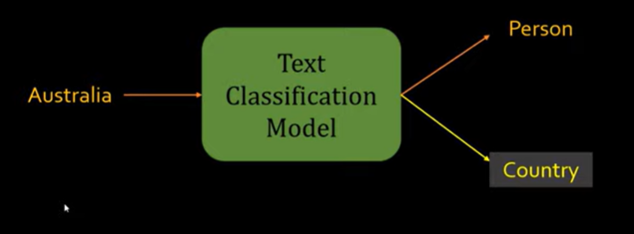
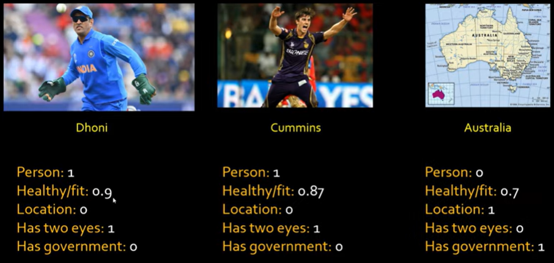
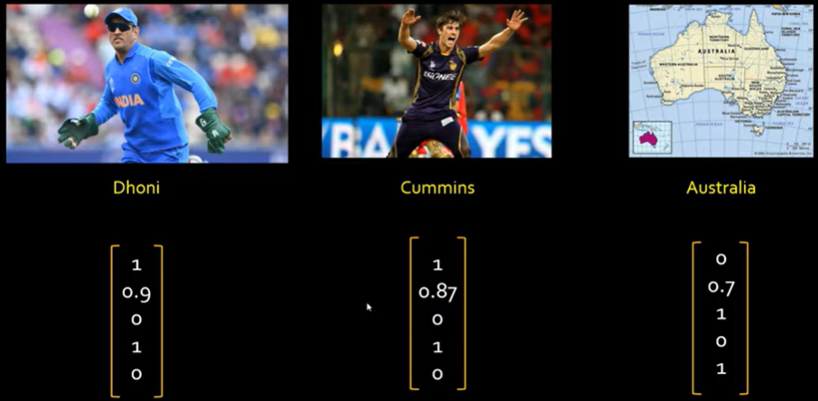

Slide 5



Accurate Email Spam Detection
Filtering Spam Messages
Filtering Spam Calls
Sentiment Analysis
Topic Labeling
Product Review Classifying

Slide 6
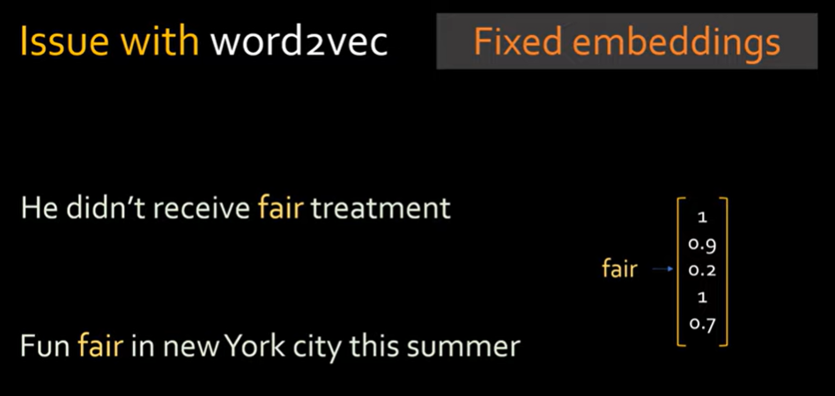
Text Classification was previously done with Machine Learning algorithms like Logistic Regression, Random Forest and K-Nearest Neighbors.
But, the deep learning algorithms such as LSTM, ANN, CNN, RNN have outperformed classical machine learning approaches.

Slide 7
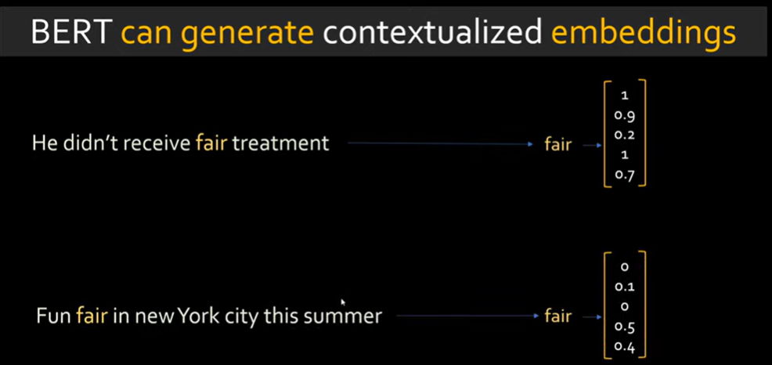
Existing system models could only read the text input sequentially.
BERT, which stands for Bidirectional Encoder Representations, is based on Transformers.
Transformer is considered a significant improvement because it doesn't process the data in a fixed order.

Slide 8
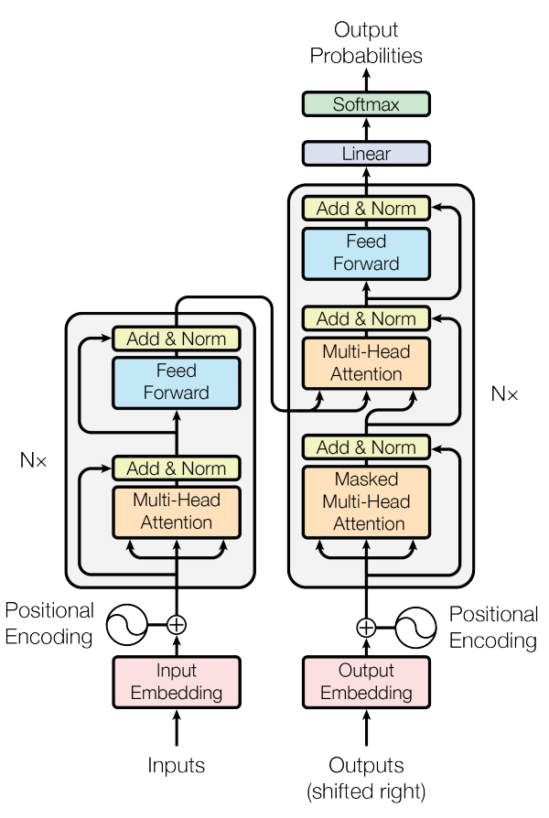
Transformers process input sequences in parallel, enabling faster training and inference.
3 key elements that make transformers so powerful:
Self-attention
Positional embeddings
Multihead attention
BERT is pre-trained on two different, but related,NLP tasks:
Masked Language Modeling and
Next Sentence Prediction.

Slide 9
Transformer networks have an advantage over LSTMs and RNNs in that they can process many words at the same time.
Which led to the rapid rise of Transformer - based models, outperforming earlier approaches like RNNs and LSTMs.
High accuracy
Training on Larger data
Less time (Bidirectional)
Faster and Efficient

Slide 10

With increasing complexity of spam mails gives rise to malicious mails and unwanted or dangerous content. It is important to properly sort out spam mails and important mails from each other. This model classifies the text to prevent loss of important data and sorts out the insignificant data.

Slide 11
Transformers For Text Classification
https://blog.paperspace.com/transformers-text-classification/
Text Classification Using BERT & Tensorflow
https://www.youtube.com/watch?v=hOCDJyZ6quA
Text Classification using Deep Learning: A Comprehensive Review
https://arxiv.org/pdf/2004.03705.pdf
Attention is All You Need - Research Article on transformers architecture.
https://arxiv.org/pdf/1706.03762.pdf?ref=blog.paperspace.com

